Slide 1
TITLE: Movie DATASET ANALYSIS
Subtitle: Trend, ratings, Revenue and forecasting
Patrick njoroge

Slide 2
introduction
Purpose of the analysis:
Primary goal of this study is to explore and understand key trends in the movie/film industry by examining relationships in the dataset(ie genres and ratings), financial performance (domestic, foreign and total gross revenue).
Datasets used:
Bom.movie_gross.csv.gz
Imdb.title.basics.csv.gz
Imdb.title.ratings.csv.gz

Slide 3
Data preperation
Data Cleaning:-
Loading and Merging the dataset on tconst.
Converting columns from object type to numeric.
Checking for missing values, duplicates and outliers, then selecting what action to do with them.
Selecting key columns to use:-
Title, year, genres, average ratings, domestic_gross, foreign_gross, and total_gross.

Slide 4
Feature engineering
Finding the performance patterns between domestic_gross column and foreign_gross column, for example, the Ratio between the two columns.
Creating a rating level used based on the average rating of the dataset, for example:-
0-5 rating level indicates poor performance.
5-8 rating level indicates an average performance.
8-10 rating level indicates that the movie is a blockbuster.

Slide 5
Univariate analysis

Slide 6
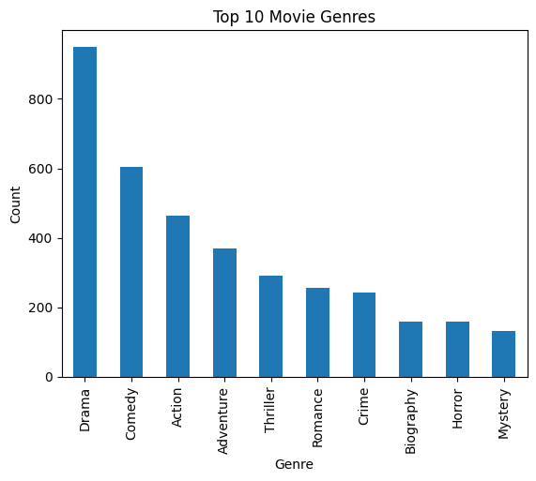
Genre frequency chart
This bar chart shows the frequency
of the top ten genres produced in the
Dataset.

Slide 7
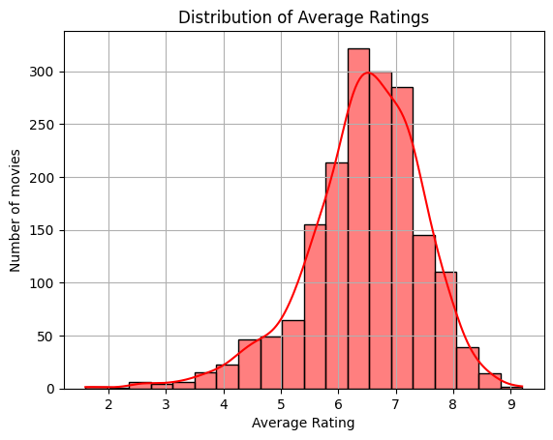
Histogram of average rating
This histogram shows the distribution of average
Ratings across the dataset
It is a negative skewed distribution as the
Mean < Median, likely due to low-value outliers
Pulling the mean down.

Slide 8
Bivariate analysis

Slide 9
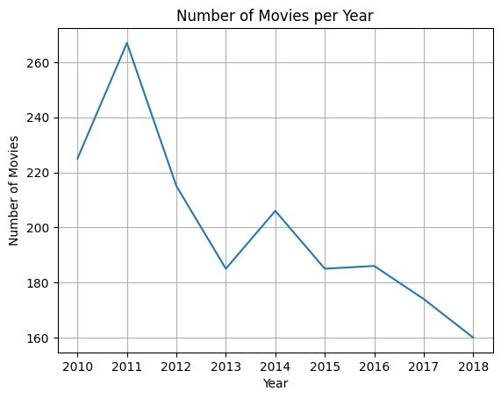
Line plot showing how movie production has changed over the years
Movie production showed a steady
rise in year 2010-2011.
2012-2013 showed a sharp decline
but had a slight rise again in 2014.
2015-2018 there was a steady decline
probably due to economical factors.

Slide 10
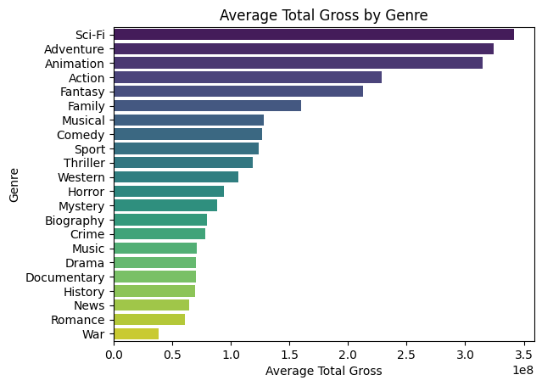
Analyzing relationship between genres and total gross to know which genres bring more revenues.
Highest earners are sci-fi, adventure
and animation genres, while lowest
earners are news, romance and war.
Although drama and comedy are in
top 10 most produced genres, they are
not among the top 10 in revenues.

Slide 11
Multivariate analysis

Slide 12
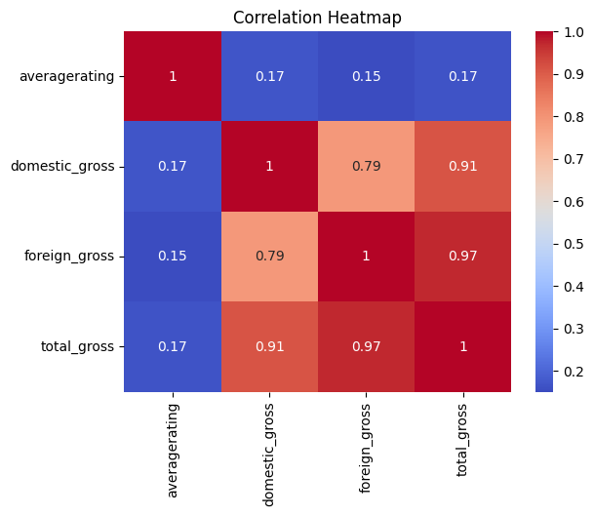
Correlation heatmap of the numerical columns
1.0 – perfect positive correlation
0.0 – no correlation
-1.0 – perfect negative correlation
There’s a strong positive correlation btwn
Total gross and/or foreign/domestic gross.
There’s almost no correlation between
Average rating and the rest.

Slide 13
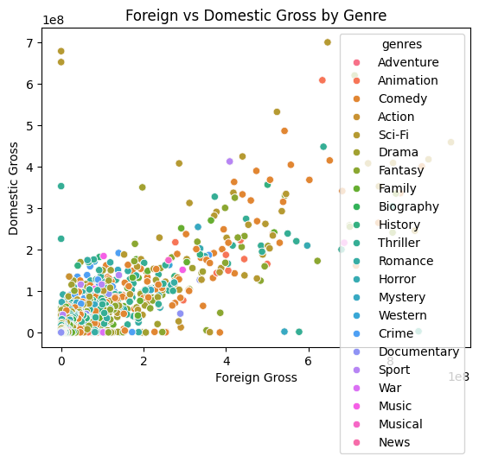
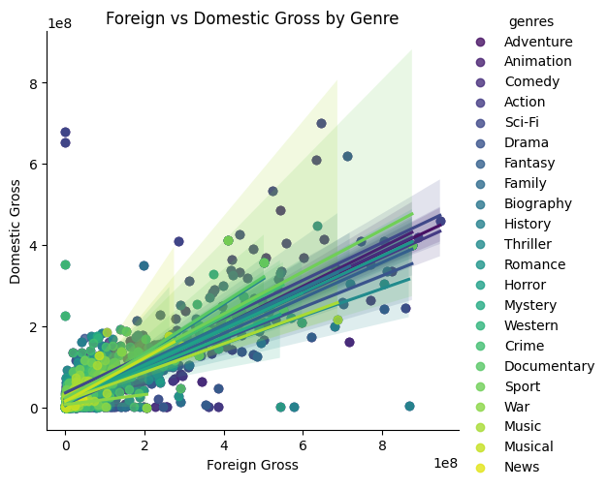
Relationship between foreign and domestic gross across different genres using a scatter plot with linear trends for each genre.

Slide 14
A steeper trendline indicates that movies in that genre tend to earn more foreign gross as domestic gross increases. For example, Action, Sci-fi and Animation genres.
A flat or weak slop suggests that foreign earnings do not scale much with domestic success. For example, Comedy and Drama genres. Humor may not translate globally due to cultural differences.

Slide 15
Key findings
Sci-fi, Adventure, Action and Animation genres are the most profitable in the market.
Drama, Comedy and Action are the most produced genres in the market currently.
High ratings does not necessarily mean automatic high revenues.
Movie production has varied over the years increasing or decreasing depending on the year. May be due to economical reasons or other factors.
Movie production depends on the target audience, ie if you are looking for domestic audience invest in a genre like drama for high ratings or domestic revenue.

Slide 16
recommendations

Slide 17
Invest more in high performing genres, such as:-
Action and Animation genres for box office success as they yield high revenues domestically and internationally.
Drama and Comedy genre as they yield high ratings and are tailor made for domestic audiences
Invest in marketing strategies to increase visibility of a movie.
Make your films stand out with great scripts and story telling. This will help when movie production increases hence great market saturation.

Slide 18
Limit overproduction of genres with low ratings and revenues, for instance Horror genre.
Analyze the target audience before a movie production, so as to know how much is to be invested and the expected revenues it can generate.
Some genres tend to earn Awards due to long term cultural values that they have, for example, Documentary and Biography genres.

Slide 19
conclusion

Slide 20
This dataset has provided a rich overview of the movie/film industry, hence the analysis has lead to some insights into the industry, for example:-
Revenue patterns can differ by market, ie, some genres have global tractions and others show strong performance domestically.
Genres influence both ratings and revenues.
Ratings are not always aligned with revenues.
By using past data and analyzing it, stakeholders can make more informed and strategic decisions so as to maximize revenues and target audiences.

